Slide 1
Folium aplications spacex
Alejandro Martinez

Slide 2
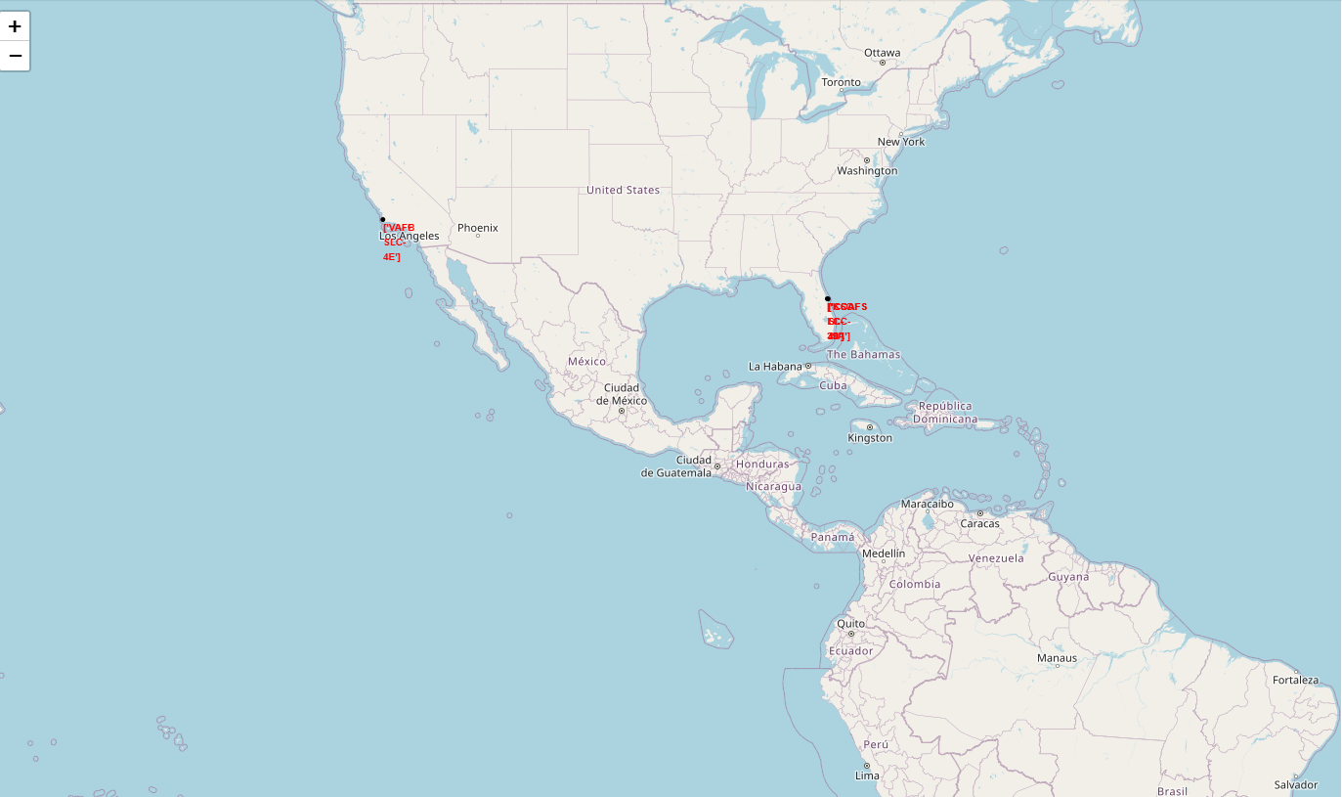
Are all launch sites in proximity to the Equator line? Answer : They are very far of there Are all launch sites in very close proximity to the coast? Answer: Yes

Slide 3
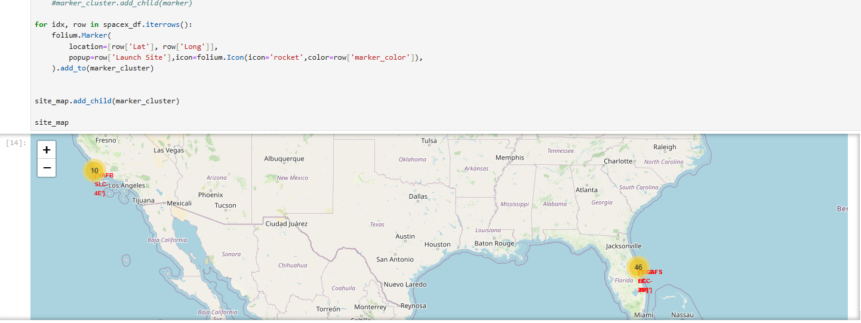
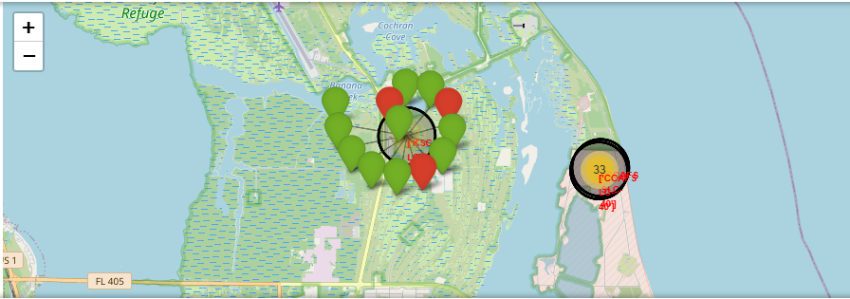

Slide 4
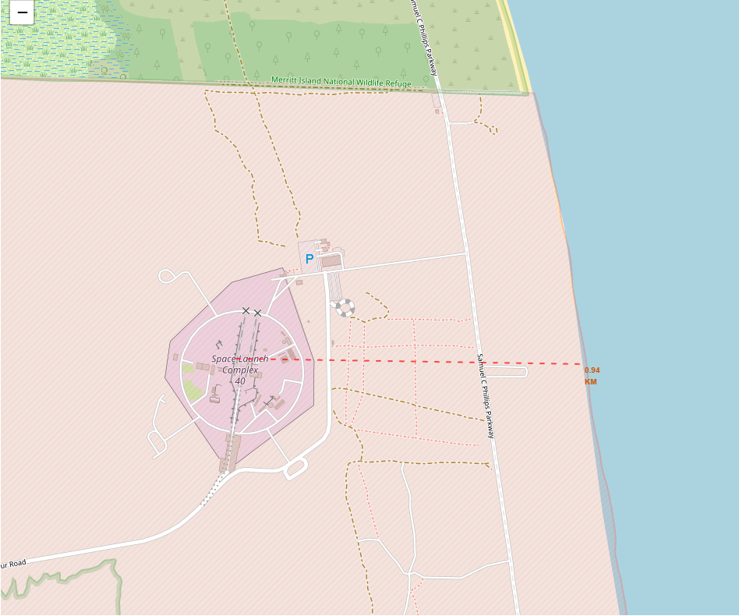
Are launch sites in close proximity to coast line? Yes 0.94km

Slide 5
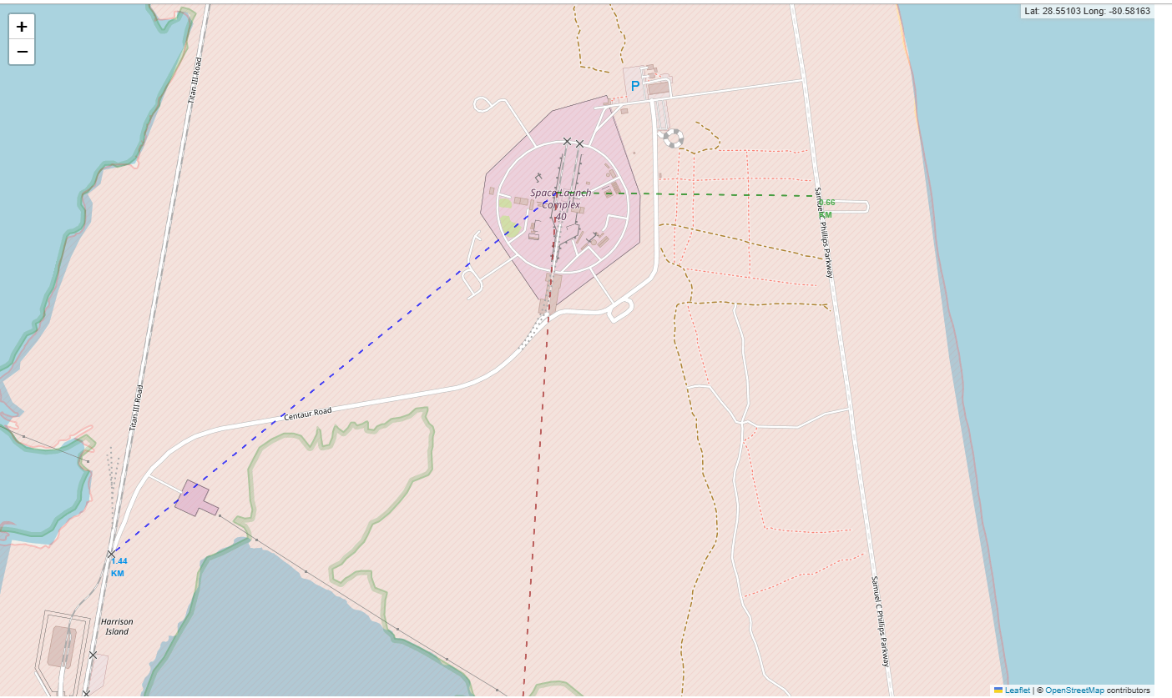
Are launch sites in close proximity to railways? Yes 1.44km

Slide 6
Are launch sites in close proximity to highways? Yes 0.66 km

Slide 7
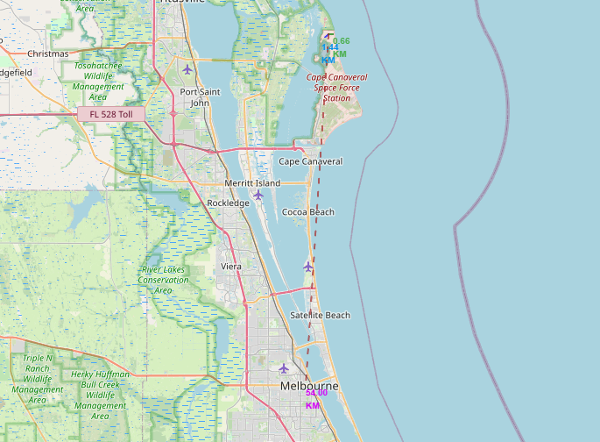
Do launch sites keep certain distance away from cities? Yes 54km

